Slide 1


Lie Detection using Convolutional Neural Network
SE Dept.
Students:
Vladimir Balagula
Elias Nijim
Supervisor:
Prof. Zeev Volkovich
Date:
11/02/2019

Slide 2
Motivation
Our project is aimed to detect a lie using human voice and investigate the dependency between a lie in English and German languages.
We have analyzed and implemented voice speech algorithm aimed to improve the model performance and improving the detection result .

Slide 3
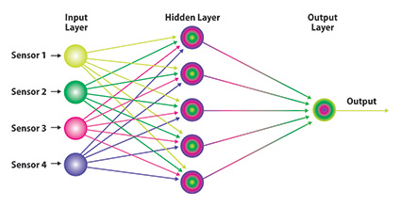
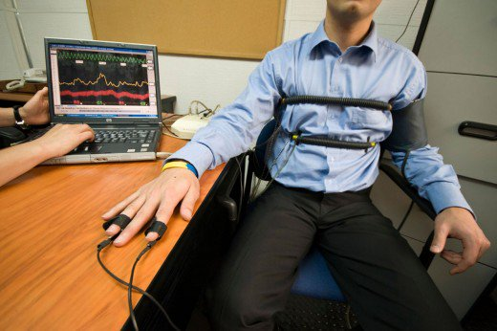
Introduction
Behavioral Sciences
Known Techniques:
Polygraph
Lie detection using Neural network article

Slide 4
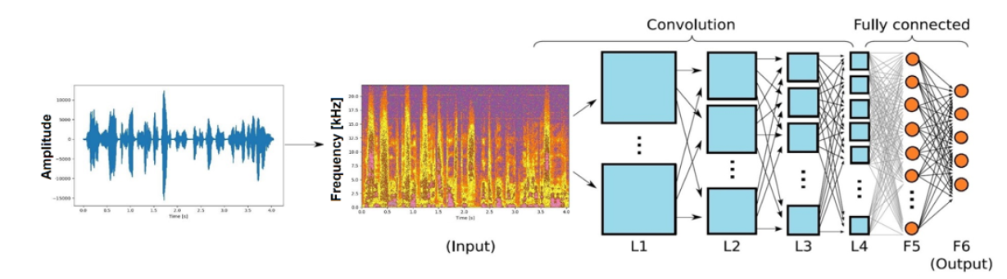
New Approach
In our project, we introduced a new method to recognize a lie. We used a convolutional neural network (CNN). This approach gave us the opportunity to analyze the voice deeper.

Slide 5

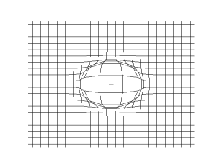
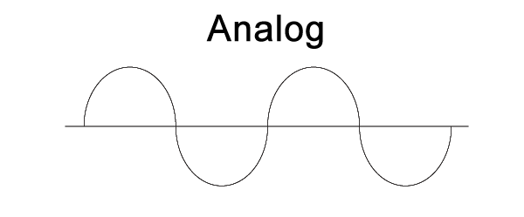
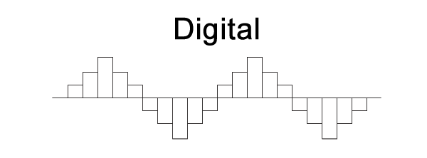
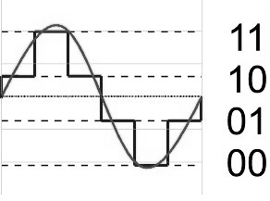


Background
Waves
Longitudinal waves - Sound
Plane pressure pulse wave
Omnidirectional pulse wave on a 2d grid
Analog and Digital signals

Slide 6
Mel-frequency cepstral coefficients (MFCCs)
Mel Frequency Cepstral Coefficient (MFCC) is commonly used in a speech recognition process and in the analyzing speech signal. The pre-step in the speech recognition system is identification of the components of a signal.
Speech
Framing and blocking
Windowing
MFCC coefficients
IFFT
Mel-Scale
FFT

Slide 7
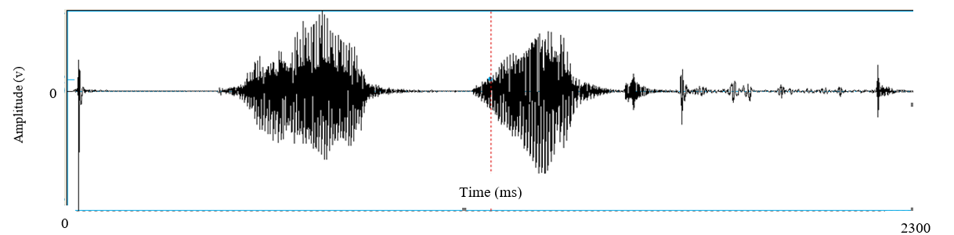
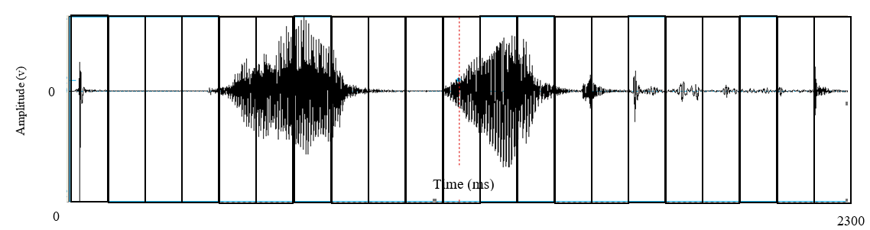
MFCC Algorithm
Framing and blocking

Slide 8
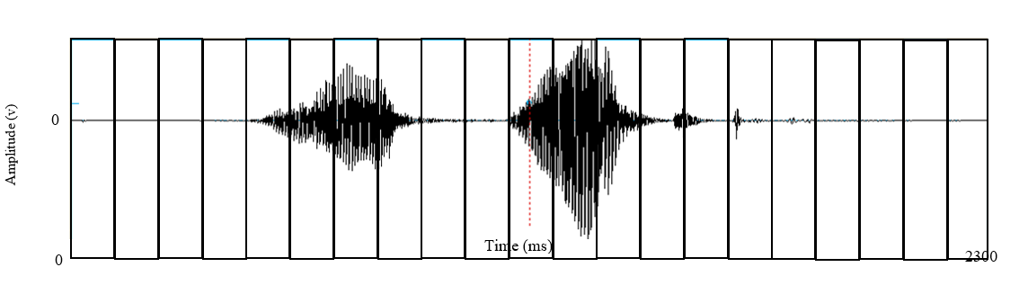
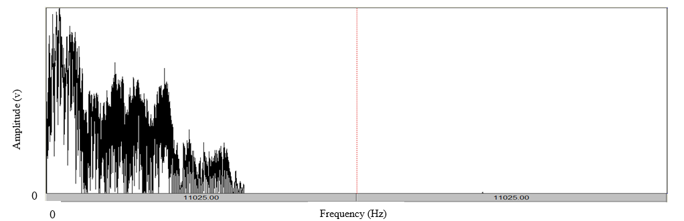
MFCC Algorithm
Windowing ( Hamming window)
FFT
FFT
FFT
FFT
FFT
FFT
FFT
FFT
FFT
FFT
FFT
FFT
FFT
FFT
FFT
FFT
FFT
FFT
FFT
FFT
FFT
Spectrum
Mel-Filters

Slide 9
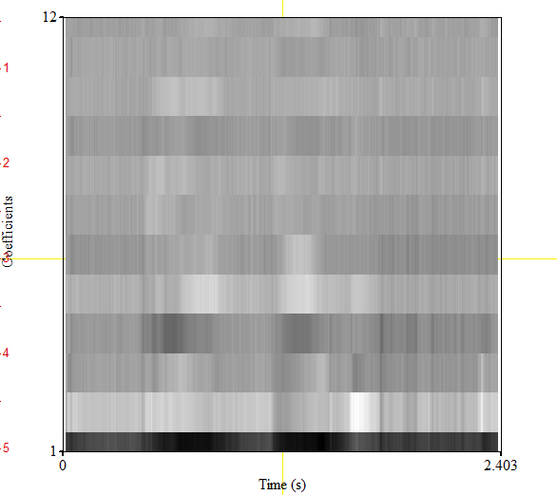
MFCC Algorithm
IFFT

Slide 10

Neural Network
Artificial Neural Network is a mathematical model inspired by biological neural networks that constitute the brain. The main goal of the network is to define dependencies between input data and wanted output at a learning phase. If The model finds the dependence, it gives the desired output on another data.

Slide 11
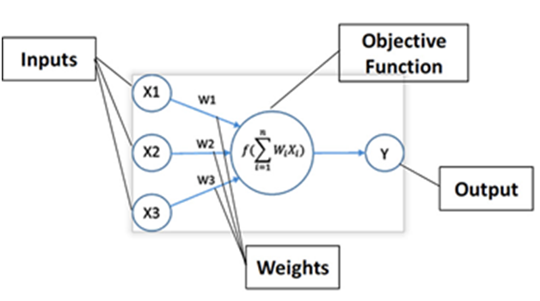
Artificial Neural Network
The model contains neurons, each neuron can communicate with other neurons from different layers. As biological neurons, the Artificial neurons has communication, input and output signals. The output depends on the input from a previous layer, and on the activation function of a particular neuron. Requirements for using NN:
A huge amount of data
Patterns
The main advantage of NN is
ability to learn.

Slide 12

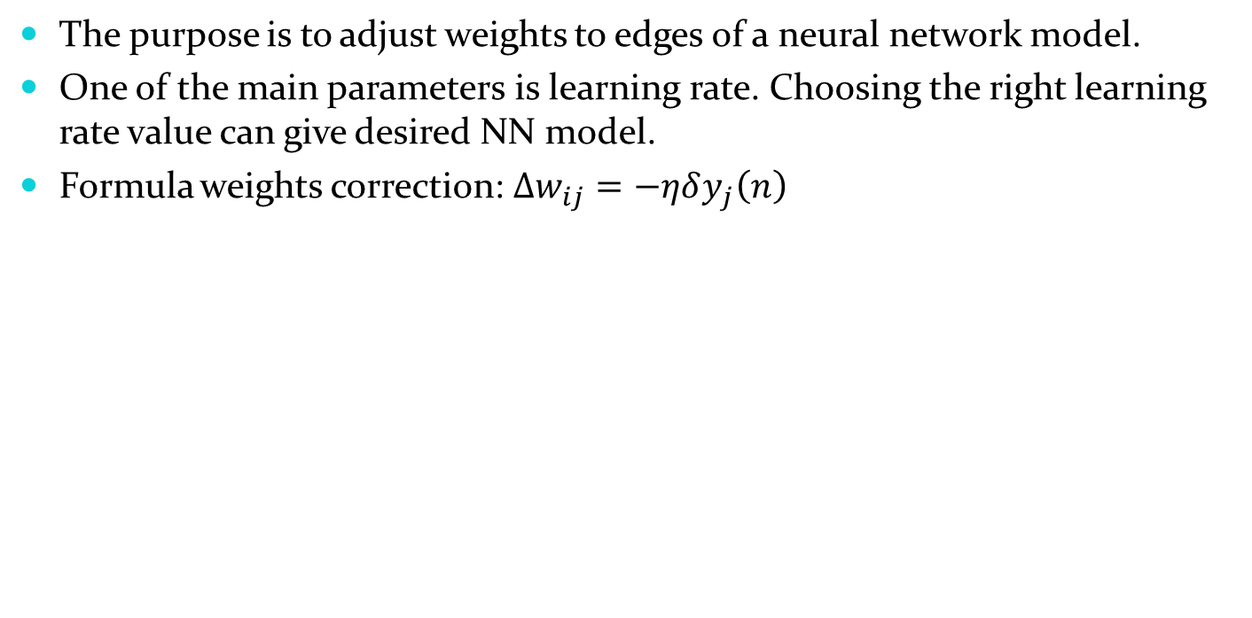
Back-Propagation
The purpose is to adjust weights to edges of a neural network model.
One of the main parameters is learning rate. Choosing the right learning rate value can give desired NN model.
Formula weights correction:$∆w_{ij}=−ηδy_{j}\left(n\right)$

Slide 13
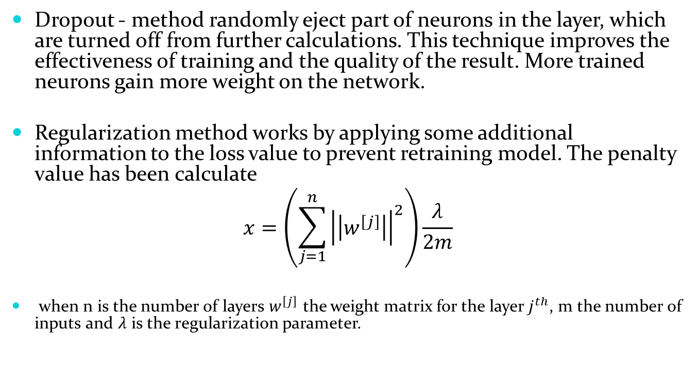
Dropout and Regularization
Dropout - method randomly eject part of neurons in the layer, which are turned off from further calculations. This technique improves the effectiveness of training and the quality of the result. More trained neurons gain more weight on the network.
Regularization method works by applying some additional information to the loss value to prevent retraining model. The penalty value has been calculate
$$x=\left(\sum_{j=1}^{n}{{\left|\left|w^{\left[j\right]}\right|\right|}^{2}}\right)\frac{λ}{2m}$$
when n is the number of layers $w^{\left[j\right]}$ the weight matrix for the layer $j^{th}$, m the number of inputs and $λ$ is the regularization parameter.

Slide 14
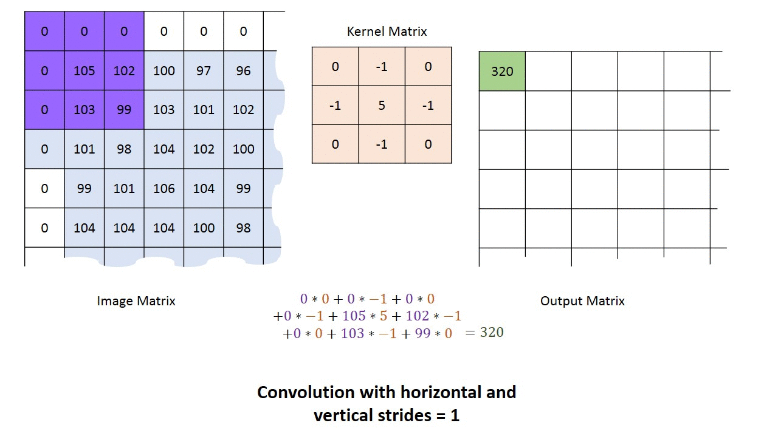
Convolution
Convolution is used to extract important features from data.
Input for convolutional must be a two-dimensional matrix.
Filters – there is a line of filters.
Each filter extract different feature by multiplying the
input in filter matrix.
Convolution applies
different filters and can
run multiple times.

Slide 15
Algorithm
Recording the voice wave using a microphone and save it as (format) .wav file .
Running MFCC on .wav to get Mel-frequency cepstral coefficients.
VGG16 convolutional pretrained Layers
Flatten Layer
Fully connected Layer with ReLu
Dropout Layer

Slide 16
Algorithm
Fully connected Layer with ReLu
Dropout Layer
Fully connected Layer with softmax activation function

Slide 17
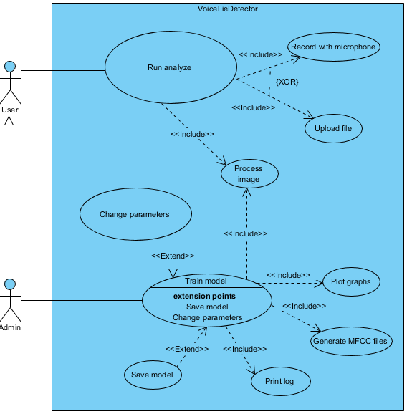
USE CASE

Slide 18
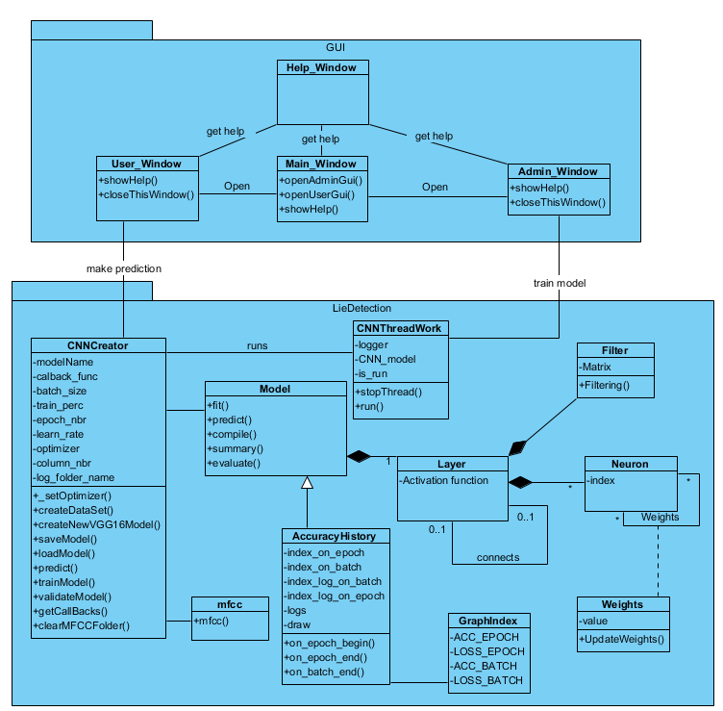
Class Diagram

Slide 19
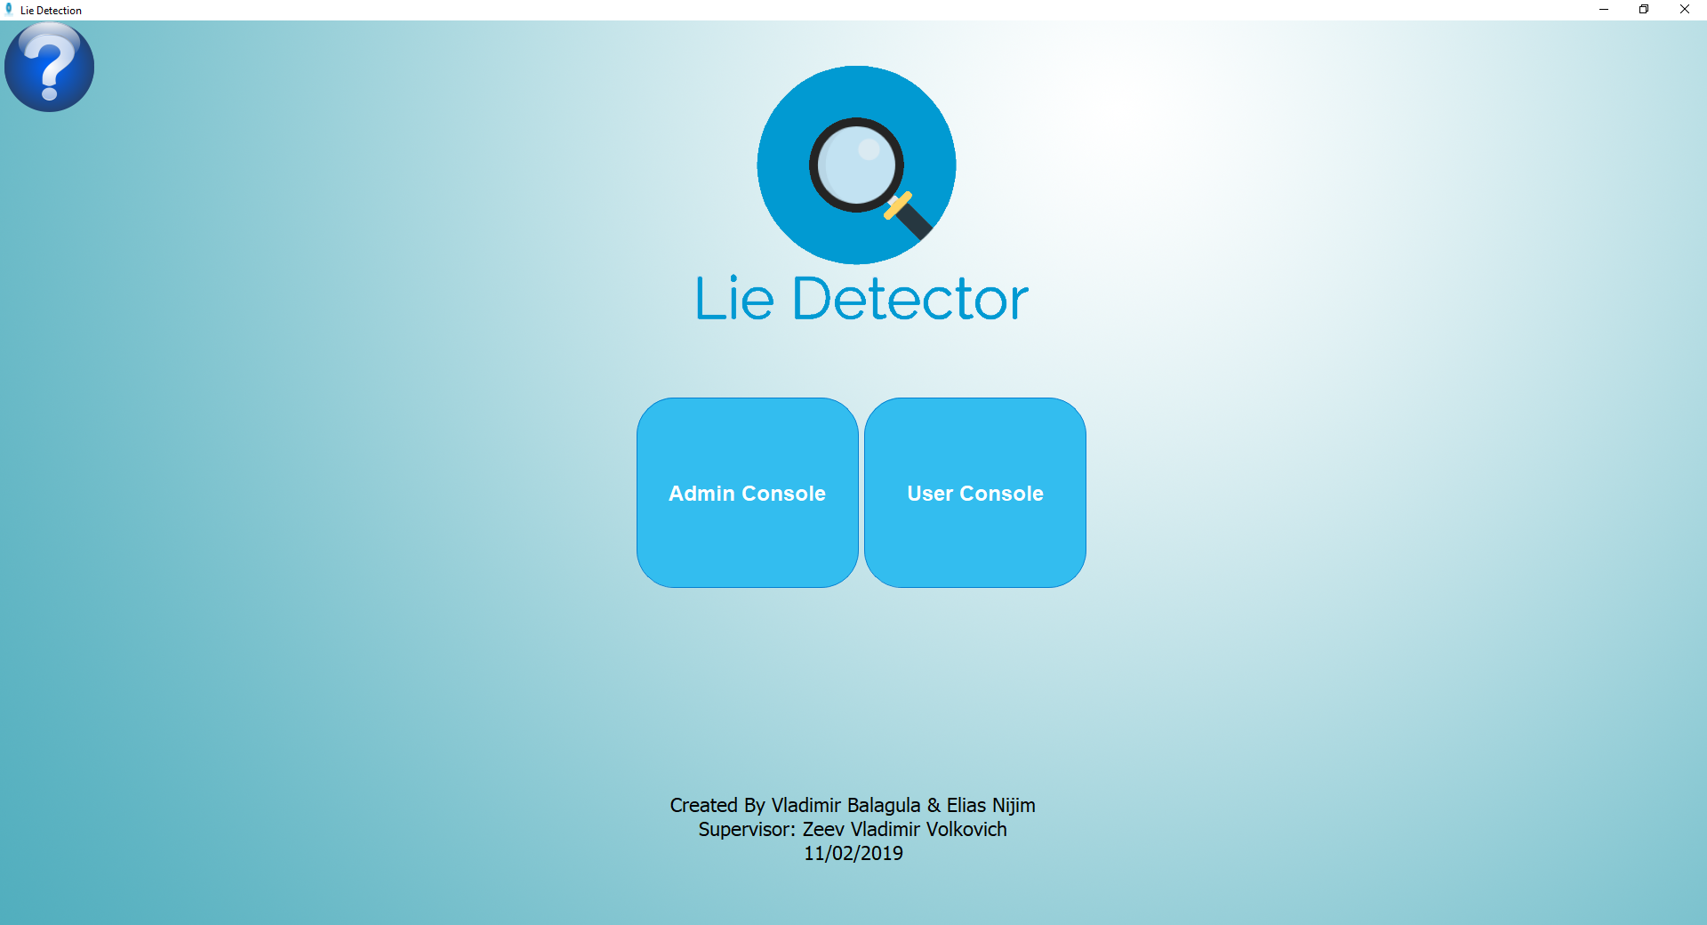
User Interface
Welcome window -
The initial window at start of the program

Slide 20
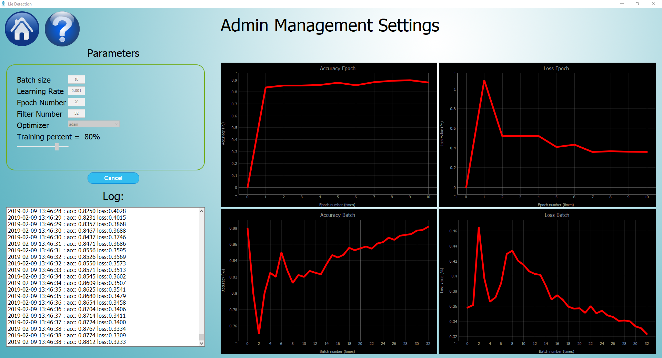
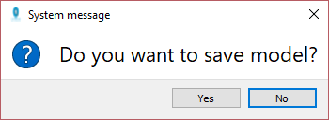
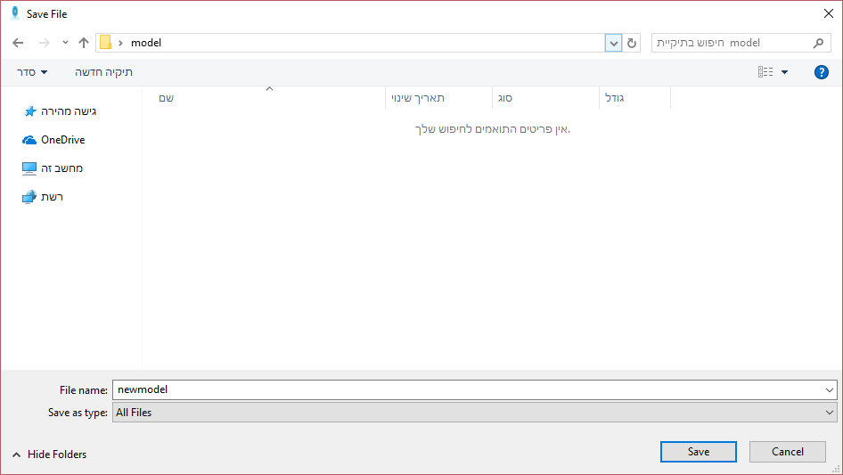
Admin Interface
Save Model Window -
Asking if the admin wants
to store the model
to use it after.
Admin Management Settings –
Giving the opportunity to teach
the model and change the model’s parameters.
Save Model Window -
Saving the model in specific path.

Slide 21
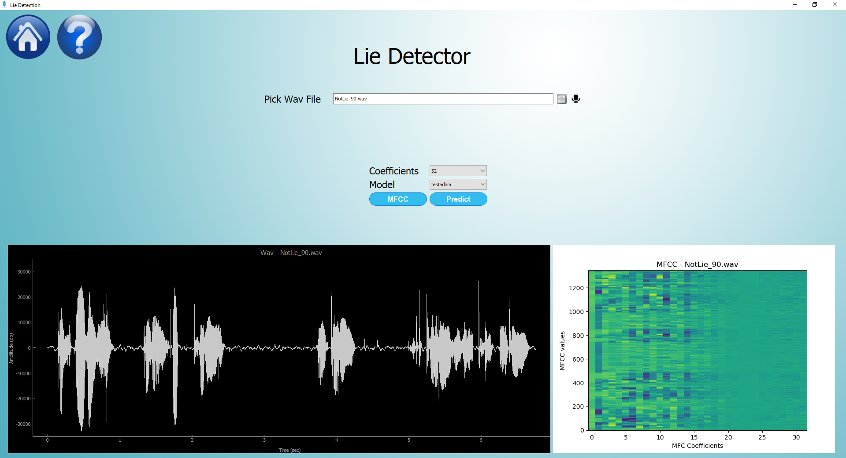
User Interface
User interface – gives the use an option to predict a lie by choosing
data source And Giving the option which data source to use
Sound wave graph
MFCC graph

Slide 22
Testing Plan
Expected result | Test description | Test name
The same result with small error | Execute function using the same data in MATLAB and in the project function | MFCC validation
Microphone starting recording if connected | Check if microphone connected while clicking on microphone to record | Microphone
1) Display sound wave plot 2) Display MFCC plot | Finish recording/Uploading file | Display voice graph
Display error window | Insert invalid parameters for Model settings | Validation parameters
Same results | Loading the saved model and executing it again | Save model
The same result | Insert the same file twice to the model | Validate model

Slide 23

Results
confusion matrix of the validation results in German
(VGG16 model with one fully-connected Layer)
 | Positive | Negative
Lie | 0 | 14
Telling a truth | 0 | 93
$$Accuracy=86\%$$
$$Recall=0$$
$$Precision=0$$

Slide 24
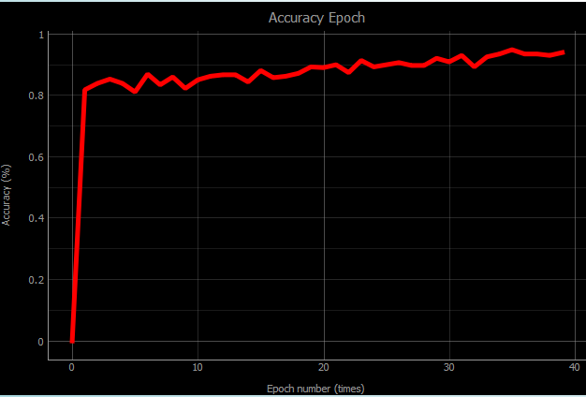
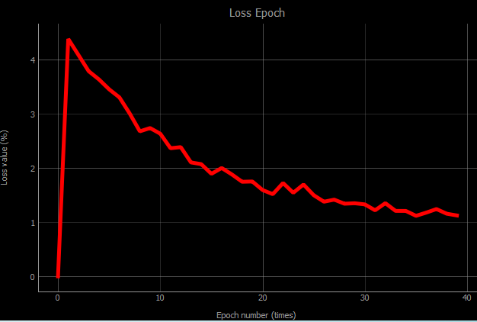
Results
Validation results in German
 | Positive | Negative
Lie | 4 | 10
Telling a truth | 1 | 92
$$Accuracy=90\% Recall=0.28 Precision=0.8$$

Slide 25
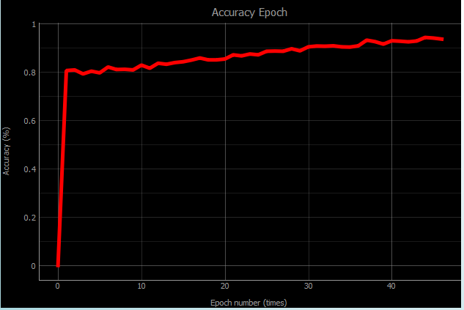
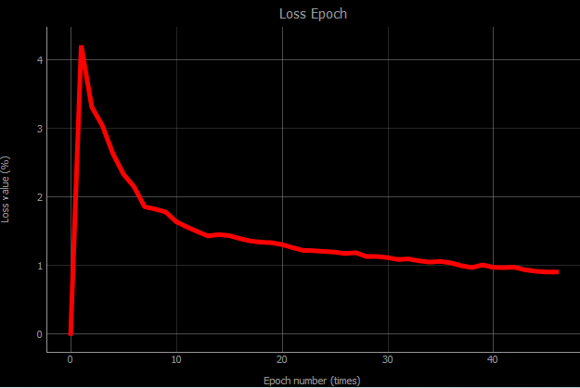
Results
Validation results in English on English Model
 | Positive | Negative
Lie | 5 | 38
Telling a truth | 10 | 235
$$Accuracy=83\% Recall=0.11 Precision=0.33$$

Slide 26
Results
German model validating on English
English model validation on German
 | Positive | Negative
Lie | 42 | 150
Telling a truth | 251 | 997
$$Accuracy=72\% Recall=0.21 Precision=0.14$$
 | Positive | Negative
Lie | 35 | 34
Telling a truth | 173 | 293
$$Accuracy=61\% Recall=0.51 Precision=0.16$$

Slide 27

Conclusions
We found that learning language has an impact on the output of the model. In order to receive higher accuracy, the input has to fit the learning language.
It is very important to use good quality dataset.
In the future, there is an option to expand the project by using additional algorithms for processing sound and adding them to the existing input in order to increase the accuracy of the results.

